Slide 1

CREDIT CARDHOLDERS CLUSTERING
USING K-MEANS CLUSTERING

Slide 2
TEAM MEMBERS
JANET CHESEREM
MAGDALINE ALUKHAVA
POLYCARP OMBOGA

Slide 3
To develop a customer segmentation model for a credit card company to help define marketing strategies.
RESEARCH OBJECTIVE

Slide 4
To segment credit cardholders into distinct groups based on their spending patterns and demographics.
To identify the characteristics of each group of credit cardholders.
To determine the optimal number of clusters for the credit cardholder data using the elbow method.
To visualize the clusters and interpret the results in terms of the characteristics of each group of credit cardholders.
To provide insights and recommendations to credit card issuers on how to target and retain their cardholders based on their clustering.
SPECIFIC OBJECTIVES

Slide 5
Loading the relevant libraries
Reading and previewing dataset
Tidying the data
Exploratory data analysis
Data pre-processing
Implementing the solution
Giving Recommendations
EXPERIMENTAL DESIGN TAKEN

Slide 6
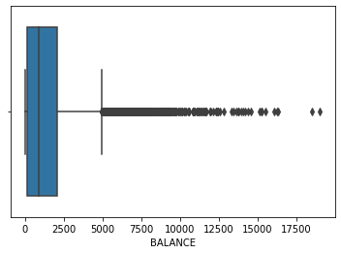
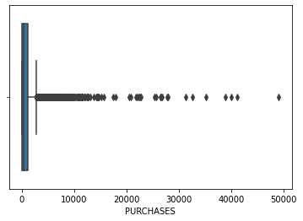
Plots to check for outliers per variable
We can observe that variables balance and purchases have outliers

Slide 7
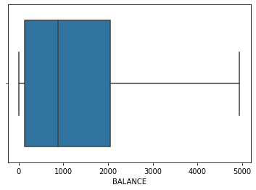
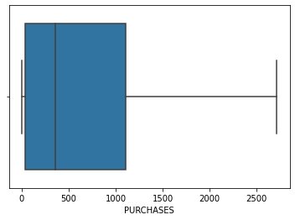
Plots after removing outliers
We can observe that variables balance and purchases have no outliers

Slide 8
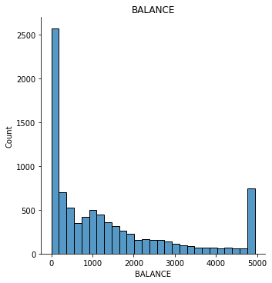
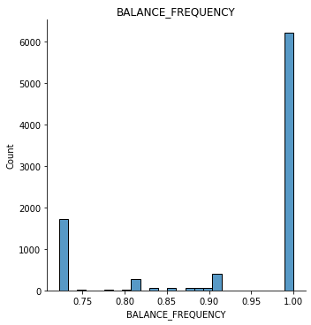
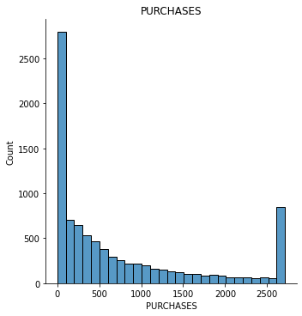
EXPLORATORY DATA ANALYSIS - Univariate analysis
Majority of the credit card holders had a balance below 1000
Majority of the credit card holders have a balance frequency of 1.00
Majority of the credit card holders have purchases of less than 500

Slide 9
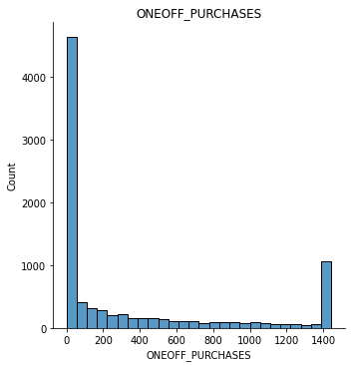
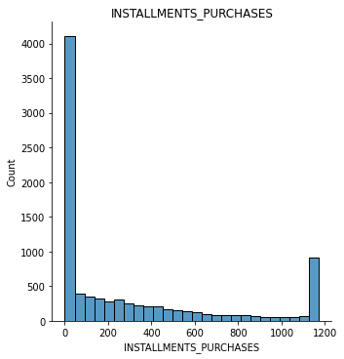
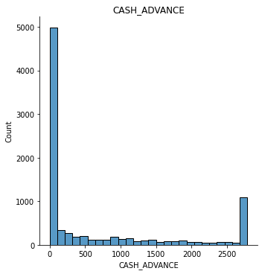
EXPLORATORY DATA ANALYSIS - Univariate analysis
Majority of the credit card holders had a one-off purchase below 200
Majority of the credit card holders have installment purchases of less than 200
Majority of the credit card holders have a cash advance of less than 500

Slide 10
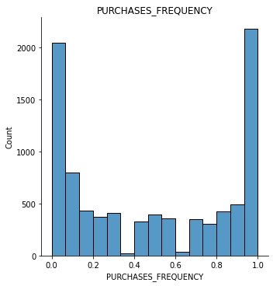
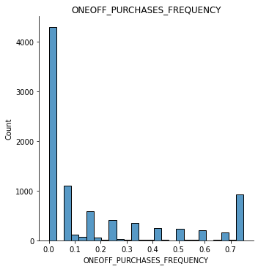
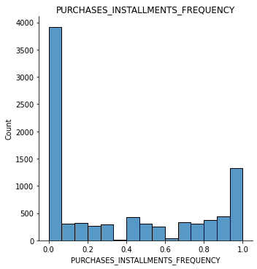
EXPLORATORY DATA ANALYSIS - Univariate analysis
Majority of the credit card holders had a purchase frequency of 1.0
Majority of the credit card holders have a one-off purchase frequency of 0.1
Majority of the credit card holders have installments frequency of 0.1

Slide 11
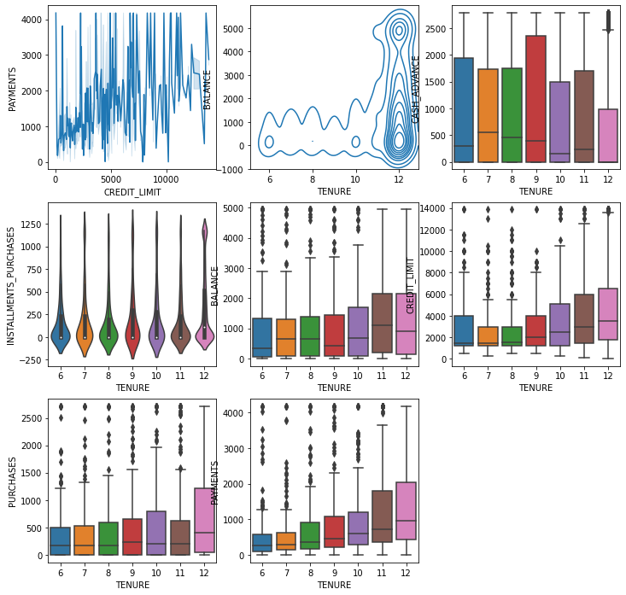
EXPLORATORY DATA ANALYSIS -Bivariate analysis

Slide 12
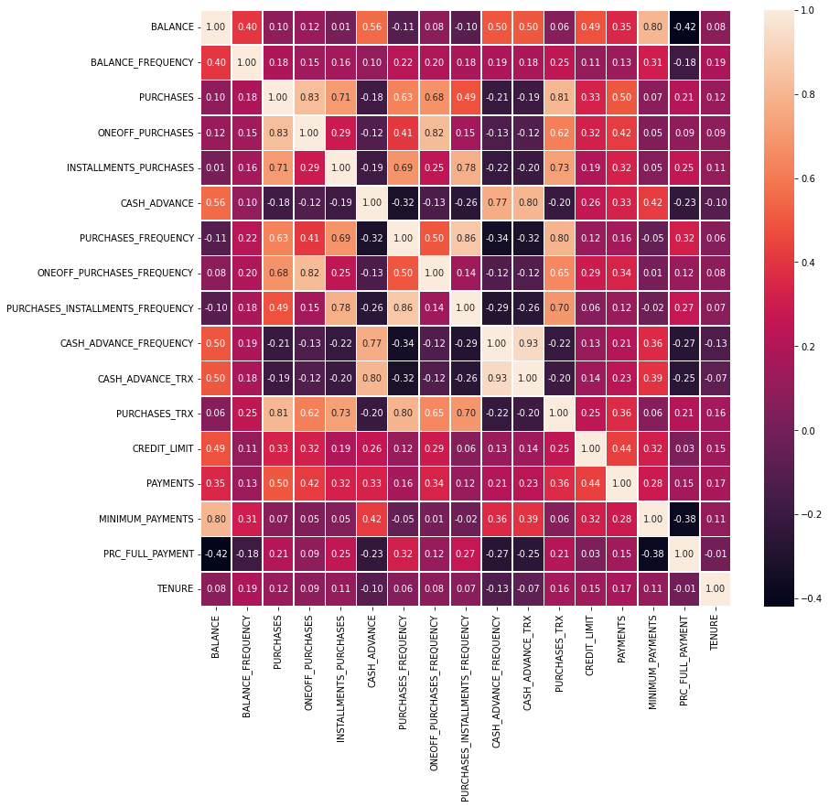
CORRELATION MATRIX PLOT - Heat map
Observation
There is a strong correlation between some variables from the data, such as between PURCHASES and ONEOFF_PURCHASES, PURCHASES_FREQUENCY and ONEOFF_PURCHASES_FREQUENCY, etc.
This result indicates that this dataset has multicollinearity and might not be suitable for various classification algorithms that have non-multicollinearity as their assumption.

Slide 13
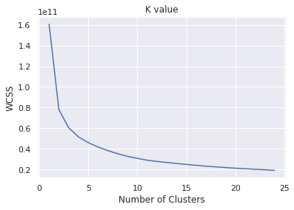
PLOTTING CLUSTER
Observation:
We can see that the optimum value of k=3

Slide 14
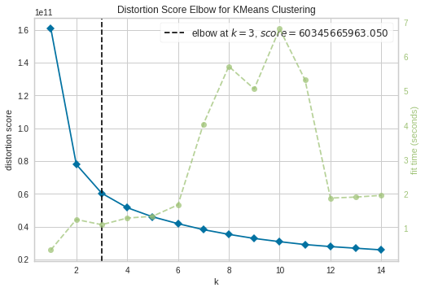
VISUALIZING USING ELBOW METHOD
Observation:
We can see that the optimum value of k=3

Slide 15
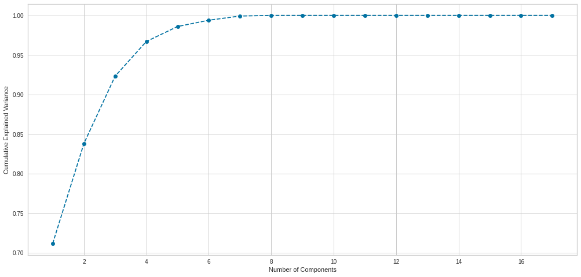
PRINCIPAL COMPONENT ANALYSIS
Based from the above results, if we want to retain a variance of almost 100% information of the data set, using 7 dimensions to do so is enough. This means that we can reduce the number of dimensions on our data set from 17 to 7 dimensions.

Slide 16
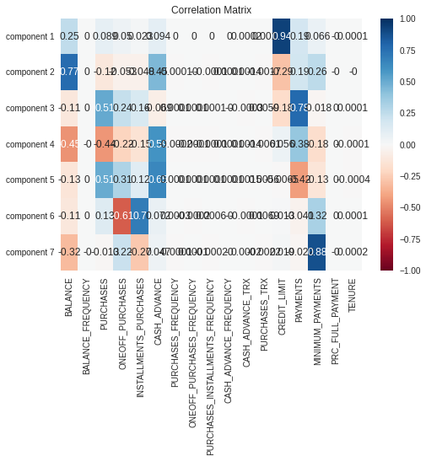
CORRELATION MATRIX OF THE PCA COMPONENTS
Observation:
Component 1 has a positive correlation with Balance ,credit limit and payments
Component 2: has a positive corrlation with balance, cash advance and minimum payments
Component 3: has a positve correlation with purchases, one off purchases, payments and installment purchases
Component 4: has a psotive correlatio with Cash advance, payments and credit limit
Component 5: Has a positve correlation with purchases, one-off purchases, installment purchases, cash advance and purchases_ frequency
Component 6: has a postive correlation with purchases, oneoff purchases, installments_purchases and cash advance
Component 7: has a positive correlation with minumu payments, one-off payment and csh advance

Slide 17
OBSERVATIONS
Component 1 has a positive correlation with Balance ,credit limit and payments
Component 2: has a positive correlation with balance, cash advance and minimum payments
Component 3: has a positive correlation with purchases, one off purchases, payments and installment purchases
Component 4: has a positive correlation with Cash advance, payments and credit limit
Component 5: Has a positive correlation with purchases, one-off purchases, installment purchases, cash advance and purchases_ frequency
Component 6: has a positive correlation with purchases, one-off purchases, installments_purchases and cash advance
Component 7: has a positive correlation with minimum payments, one-off payment and csh advance

Slide 18
K-MEANS CLUSTERING USING PCA
OBSERVATIONS
Based on the data used in this report and the K_Means Clustering process that has been done, we can conclude that:
Cluster 1: Customers with lowest amount of all purchases, not much withdrawals, indicates not many transactions of the credit card compared to the other clusters.
Cluster 2: Customers with lowest amount of withdrawal and frequency, however, have the highest amount of all purchases. They have the longest tenure and highest percent of full payments paid, indicating that they are aware of their credits.
Cluster 3: Customers with high amount of balance, high cash advance and high credit limit. Their balance also seemed to be updated frequently, indicates many transactions of the credit card. The customers of this cluster also have lowest amount of minimum payments, highest percent of full payments paid, indicating higher loans amount and often like to withdraw a lot of money from the credit card.

Slide 19
Based on the clusters that have been produced, a few business suggestions can be made to profit the industry, such as:
Cluster 1 have the lowest amount of purchases compared with the other clusters, hence if there are offers such as reward programs, discounts using credit card, they could be the best target.
Cluster 2 & 3 has the highest amount of payments compared with the other clusters, indicating how aware they are of their credits. Hence, if there are offers such as loyalty points, they could be the best target.
RECOMMENDATIONS

Slide 20
END

